Slide 1

Uncovering Public Mental Health Signals on Reddit
A Time-Normalized Emotion and Sentiment Study

Slide 2
TEAM MEMBERS:
Zain Baig - 22K4593
Arsalan - 22K4614
Umer Ahmed - 22K4213
Qasim Naveed - 22K4380
Maaz Kashif - 22K4518
Abdul Rafay - 22K4192

Slide 3
Table of Contents
• INTRODUCTION
• LITERATURE REVIEW
• FINDINGS
• DISCUSSION
• CONCLUSION
• RECOMMENDATION

Slide 4
ABSTRACT
This study investigates how Reddit can be used to analyze public mental health trends over time. Unlike previous work, it corrects for temporal imbalances—like posting surges during events such as COVID-19—by using a time-normalized sentiment and emotion analysis approach. By analyzing mental health-related subreddits with NLP models, the research captures authentic shifts in public mood, offering deeper insights for mental health stakeholders.
1

Slide 5
INTRODUCTION
Social media platforms, especially Reddit, serve as a rich data source for studying mental health discourse due to their anonymity and topic-based communities. This study analyzes Reddit posts spanning several years using advanced NLP methods to classify sentiment and emotion. A key innovation is the time normalization technique, which adjusts for fluctuations in posting activity across time to reveal genuine emotional and psychological trends.
2

Slide 6
Research Objectives
Identify temporal trends in public sentiment and emotional expression related to mental health.
Address temporal skew in social media datasets to reveal long-term psychological shifts.
Compare sentiment-emotion correlation across mental health subreddits.
Generate actionable insights for mental health professionals, policymakers, and platform moderators.
3

Slide 7
Significance of the Study
Limitations and Delimitations
Limitations:
Focus on English-language Reddit posts.
Exclusion of deleted posts and user demographic information.
Delimitations:
Analysis confined to specific mental health subreddits.
Time normalization may miss micro-trends within high-activity periods.
Provides insights into how public mental health evolves in response to global events and societal changes.
Emphasizes the importance of context-aware digital mental health monitoring.
4

Slide 8
LITERATURE REVIEW
Past studies explored:
Emoji-based sentiment (Chen et al.)
Engagement-based trend prediction (Bandari et al.)
Real-time analytics using Spark (Sharma & Ghosh)
Comparative tools for social media analysis (Fan & Gordon)
This study builds on such work but addresses the gap in temporal bias correction in sentiment/emotion analysis.
4

Slide 9
METHODOLOGY
Data Collection: Reddit API (PRAW), 15 mental health subreddits.
Preprocessing: Cleaning, stopword removal, text normalization.
Sentiment Analysis: RoBERTa (twitter-roberta-base-sentiment).
Emotion Detection: Hartmann DistilRoBERTa (emotion classification).
Time-Normalization: Normalize emotion/sentiment by month to correct data skew.
Insight Generation: Charts, heatmaps, pie charts, word clouds
4

Slide 10
Data Collection
Subreddits Analyzed:
r/depression
r/Anxiety
r/MentalHealth
r/OCD
r/bipolar
r/lonely
r/mental illness
r/panic attacks
Time Frame: Multiple years to capture evolving discourse (2017-2025).
Filtering Criteria:
English language
Post relevance
Minimum length requirements
Filtering Criteria:
English language
Post relevance
Minimum length requirements
4

Slide 11
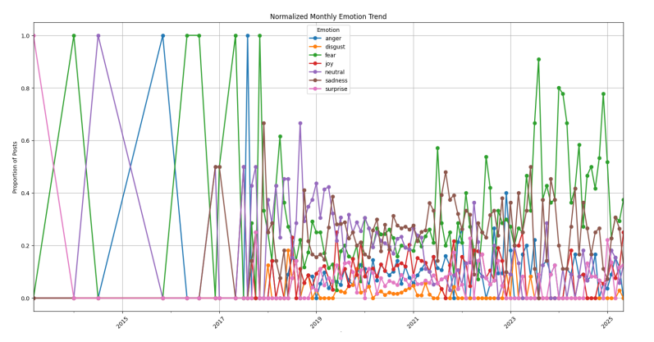
Key Findings
1) Longitudinal Trends
Gradual increase in negative sentiment and fear over years
COVID-19 era and 2024 show peak sadness and fear
External events like war and inflation show emotional impact
6

Slide 12
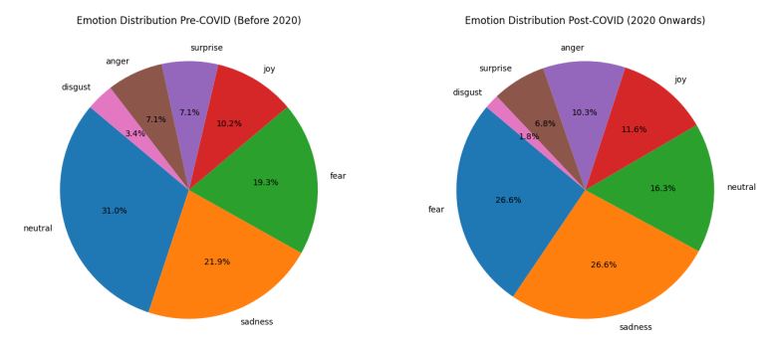
Key Findings
2) Pre vs Post COVID
Negative sentiment rose from 40.9% (pre) to 53.4% (post)
Sadness increased from 21% to 26%
Fear increased from 19% to 27%
6

Slide 13
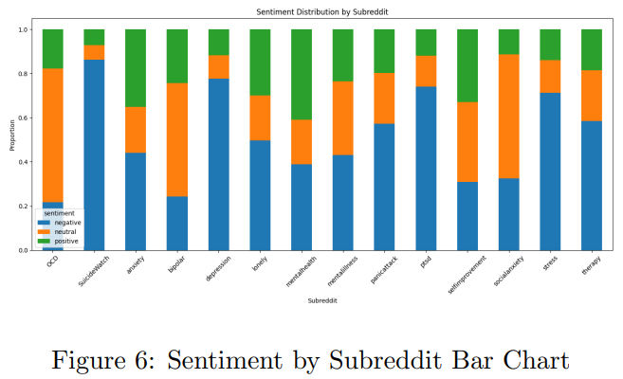
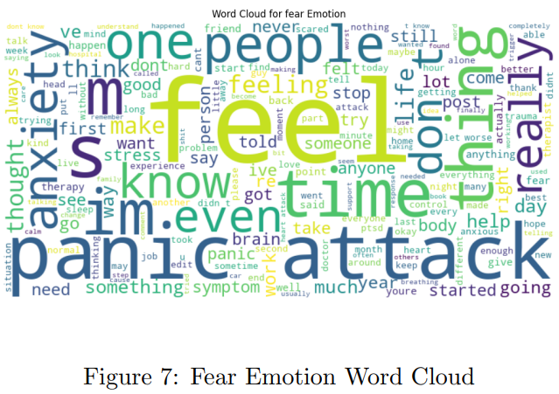
Key Findings
3) Subreddit Analysis
r/SuicideWatch, r/depression had highest negativity
r/panicattacks shows extreme fear; r/bipolar shows some positivity
Word clouds reveal frequent terms tied to fear, sadness, and anger
6

Slide 14
CONCLUSION
Reddit data, when time-normalized, offers deep insights into evolving public mental health.
Spikes in sadness and fear are not anomalies—they reflect lasting psychological impacts.
Temporal normalization is critical to avoid misleading interpretations in social media analysis.
7

Slide 15
Recommendations
Crisis Monitoring Systems: Integrate sentiment and emotion tracking into real-time monitoring dashboards for mental health organizations.
Platform-Level Interventions: Implement automated flagging or support prompts when users exhibit signs of emotional distress.
Policy and Outreach Timing: Scale mental health awareness campaigns and support services proactively during periods of known societal stress.
Community-Level Engagement: Encourage balanced discourse by fostering peer-support and recovery narratives in highly negative subreddits.
Future Research Expansion: Extend framework to include demographic
7

Slide 16
THANKmYOU
For your attention

